Slide 1

Batch : A10
GOKARAJU RANGARAJU
Institute of Engineering and Technology
Major Project Internal Review - 02
IntelliQuiz – A Gamified Adaptive Quiz Generator Using LLMs with Real-Time Analytics
Department of Information Technology
Under the Guidance of
Mrs. A. Pavithra
Assistant Professor
Department of IT
Team members:
Gnaneshwar Reddy Yenna (22241A1264)
Ponnamanda Eswar (22241A1244)
Madupathi Nithin Kumar (22241A1233)

Slide 2
ABSTRACT
IntelliQuiz is an AI-powered quiz platform that leverages Large Language Models (LLMs) to automatically generate multiple-choice questions (MCQs) from resources like PDFs, YouTube videos, or raw text. It features an Adaptive Difficulty Engine that adjusts question difficulty based on real-time student performance, a Gamified UI to enhance engagement, and Analytics Dashboards for both teachers and students to track progress and weak areas. The system supports role-based access for Admin, Teacher, and Student, ensuring personalized functionalities for each role.

Slide 3
PROBLEM STATEMENT
Traditional quiz systems are static, repetitive, and fail to adapt to a learner’s pace or strengths/weaknesses. Teachers spend time manually creating questions, and students often lack engaging feedback or analytics to track improvement. There’s a need for an intelligent, automated, and gamified system that can generate adaptive quizzes from diverse learning materials while providing instant insights.

Slide 4
PROPOSED SOLUTION
1) Content Processing: Extract text from uploaded resources.
2) LLM Integration: Send processed content to Google Gemini Pro or OpenAI API to generate MCQs tagged with difficulty levels.
3) Adaptive Engine: Adjusts difficulty based on student responses (level up/down logic).
4) Gamification Layer: Points, badges, leaderboards for classrooms.
5) Analytics Module: Real-time dashboards showing performance trends and topic weaknesses.
6) Architecture: React frontend + Spring Boot backend + PostgreSQL DB, deployment.

Slide 5
LITERATURE SURVEY
Title (Year) | Authors / Institution | Objective / Scope | Methodology / Tech Used | Key Findings / Contributions | Relevance to IntelliQuiz
Intelligent Integrated Knowledge Discovery Platform (2025) | Chaudhary et al. (Sharda Univ., India) | AI-based system for question generation and adaptive learning. | Used NLP (BERT, GPT-4) + RL for auto question generation and difficulty adjustment. | High accuracy in question generation; improved learning efficiency. | Shows how LLMs can automate quiz creation and adapt difficulty.
Bridging the Gap: AI and the Future of Learning (2025) | Kumar, R. (India) | AI’s impact on education post-NEP 2020. | Analytical review with case studies of AI tools in education. | AI improves inclusivity and personalized learning. | Validates IntelliQuiz’s focus on scalable AI learning in Indian context.
Smart MCQ Generator using RAG + LLM (2025) | Singaravel et al. (K.S.R. College, India) | Intelligent MCQ generation for adaptive learning. | Used RAG + prompt-engineered LLMs with student performance tracking. | Adaptive quizzes improved engagement and comprehension. | Reinforces IntelliQuiz’s adaptive quiz logic and AI-based personalization.
Automated Question Generation with LLMs (2024) | Maity & Deroy (IIT Kharagpur) | Explores LLMs in question creation and grading. | Reviewed prompting, fine-tuning, and automated feedback methods. | LLMs can generate high-quality questions and assess answers. | Aligns with IntelliQuiz’s use of prompt tuning and instant feedback.
AI-Driven Adaptive Learning (2025) | Strielkowski et al. (UC Berkeley, Prague Univ.) | Reviews adaptive AI in education for sustainability. | Bibliometric analysis of 3,500+ studies on adaptive learning. | AI learning improves accessibility but needs ethical oversight. | Highlights ethics and privacy importance for IntelliQuiz design.

Slide 6
Title (Year) | Authors / Institution | Objective / Scope | Methodology / Tech Used | Key Findings / Contributions | Relevance to IntelliQuiz
UC-100 Agentic AI Quiz Generation (2025) | Sreekanth, D. (KSU, USA) | Context-aware adaptive quiz generation. | Used LangChain + Gemini + multi-agent LLM workflow. | Accuracy boosted to 93%; reliable quiz generation. | Provides workflow inspiration for IntelliQuiz’s LLM integration.
AI Adaptive Learning Platforms Review (2025) | Tan et al. | Reviews AI-based adaptive learning systems. | Systematic review of ML & RL-based personalization models. | ALPs enhance engagement but face explainability issues. | Helps IntelliQuiz adopt proven adaptive feedback methods.
Effectiveness of AI Quiz Creation (2025) | Kusam et al. (ASEE) | Case study on ChatGPT-based quizzes. | Compared AI vs teacher-made quizzes in class. | AI quizzes easier but faster to generate. | Supports adding quality checks & alignment tools in IntelliQuiz.
Gamification & Adaptive Learning (2025) | Weiß, F. (Germany) | Discusses AI personalization & gamification. | Industry interview on AI + gamified learning. | Gamification boosts motivation & participation. | Validates IntelliQuiz’s leaderboard and badge system.
AI Quiz Generators in Training (2025) | QuestionPro Team | AI for corporate quiz automation. | Adaptive quizzes + performance analytics. | Saves time, boosts engagement & personalization. | Mirrors IntelliQuiz’s efficiency goals and adaptive design.
SocratiQ – AI Learning Companion (2025) | Jabbour et al. (Harvard Univ.) | Conversational AI for adaptive quizzes. | LLM embedded in e-textbook for Q&A tutoring. | Increased engagement & comprehension. | Demonstrates IntelliQuiz’s potential for interactive AI learning.

Slide 7
Title (Year) | Authors / Institution | Objective / Scope | Methodology / Tech Used | Key Findings / Contributions | Relevance to IntelliQuiz
Gamifying Learning with AI (2024) | Gómez Niño et al. | Review of AI + gamification for skills. | PRISMA review of 175 studies. | AI + gamification improves motivation & learning. | Supports IntelliQuiz’s hybrid adaptive-gamified approach.
Adaptive Gamification in Science Learning (2024) | Zourmpakis et al. | Studies adaptive gamification in classrooms. | Experimental study comparing adaptive vs traditional learning. | Adaptive gamification improved learning outcomes. | Supports IntelliQuiz’s adaptive game mechanics for quizzes.
AI-Based Quiz System iQS (2023) | Wang et al. (DFKI, Germany) | Prototype AI quiz generator integrated with LMS. | Uses ontology-based knowledge modeling + instant feedback. | Positive feedback, improved self-learning. | Confirms IntelliQuiz’s model feasibility and LMS integration potential.
Adaptive Gamification in Virtual Classrooms (2023) | Zairon et al. | Review of adaptive gamified e-learning. | Analyzed adaptive game elements in online settings. | Personalization sustains engagement in virtual learning. | Guides IntelliQuiz’s adaptive quiz difficulty & reward system.
Question Generation for Adaptive Education (2021) | Srivastava & Goodman | Generates targeted educational questions via AI. | LM-KT model predicts learner accuracy → generates calibrated questions. | Created personalized, difficulty-controlled questions. | Provides foundation for IntelliQuiz’s adaptive quiz generation model.

Slide 8
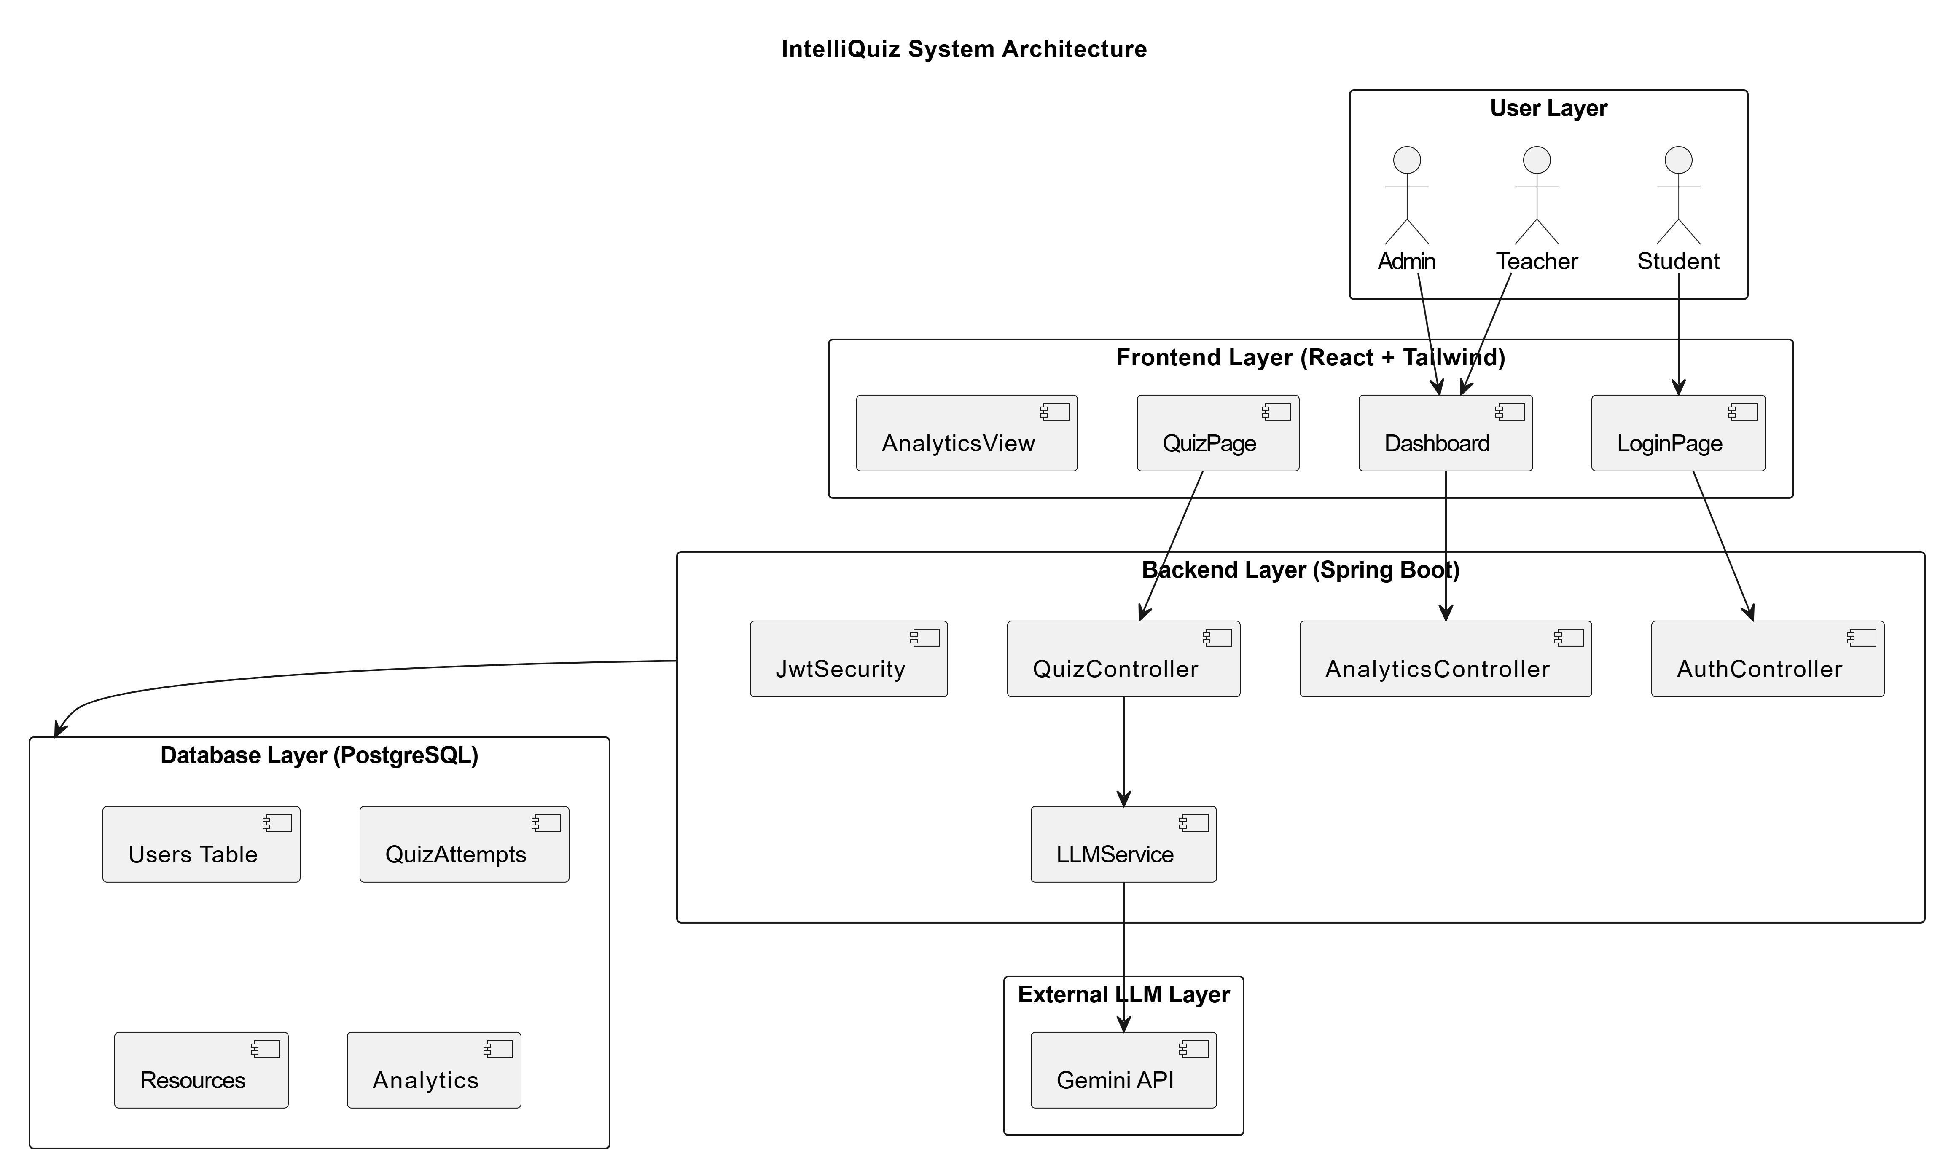
IntelliQuiz System Architecture

Slide 9
UML DIAGRAMS

Slide 10

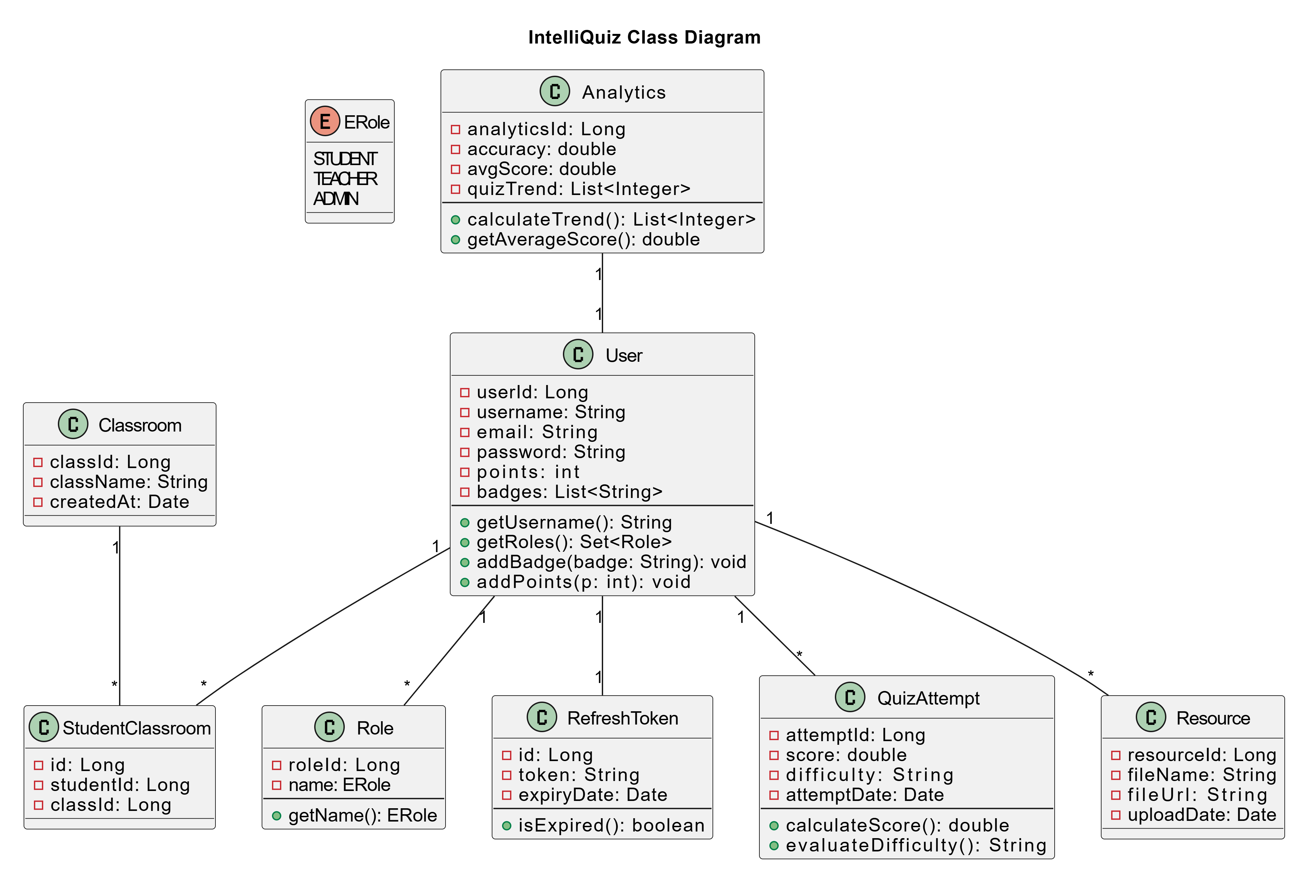
IntelliQuiz Class Diagram

Slide 11
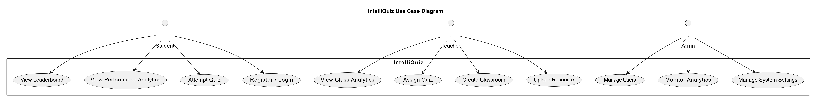
IntelliQuiz Use Case Diagram

Slide 12
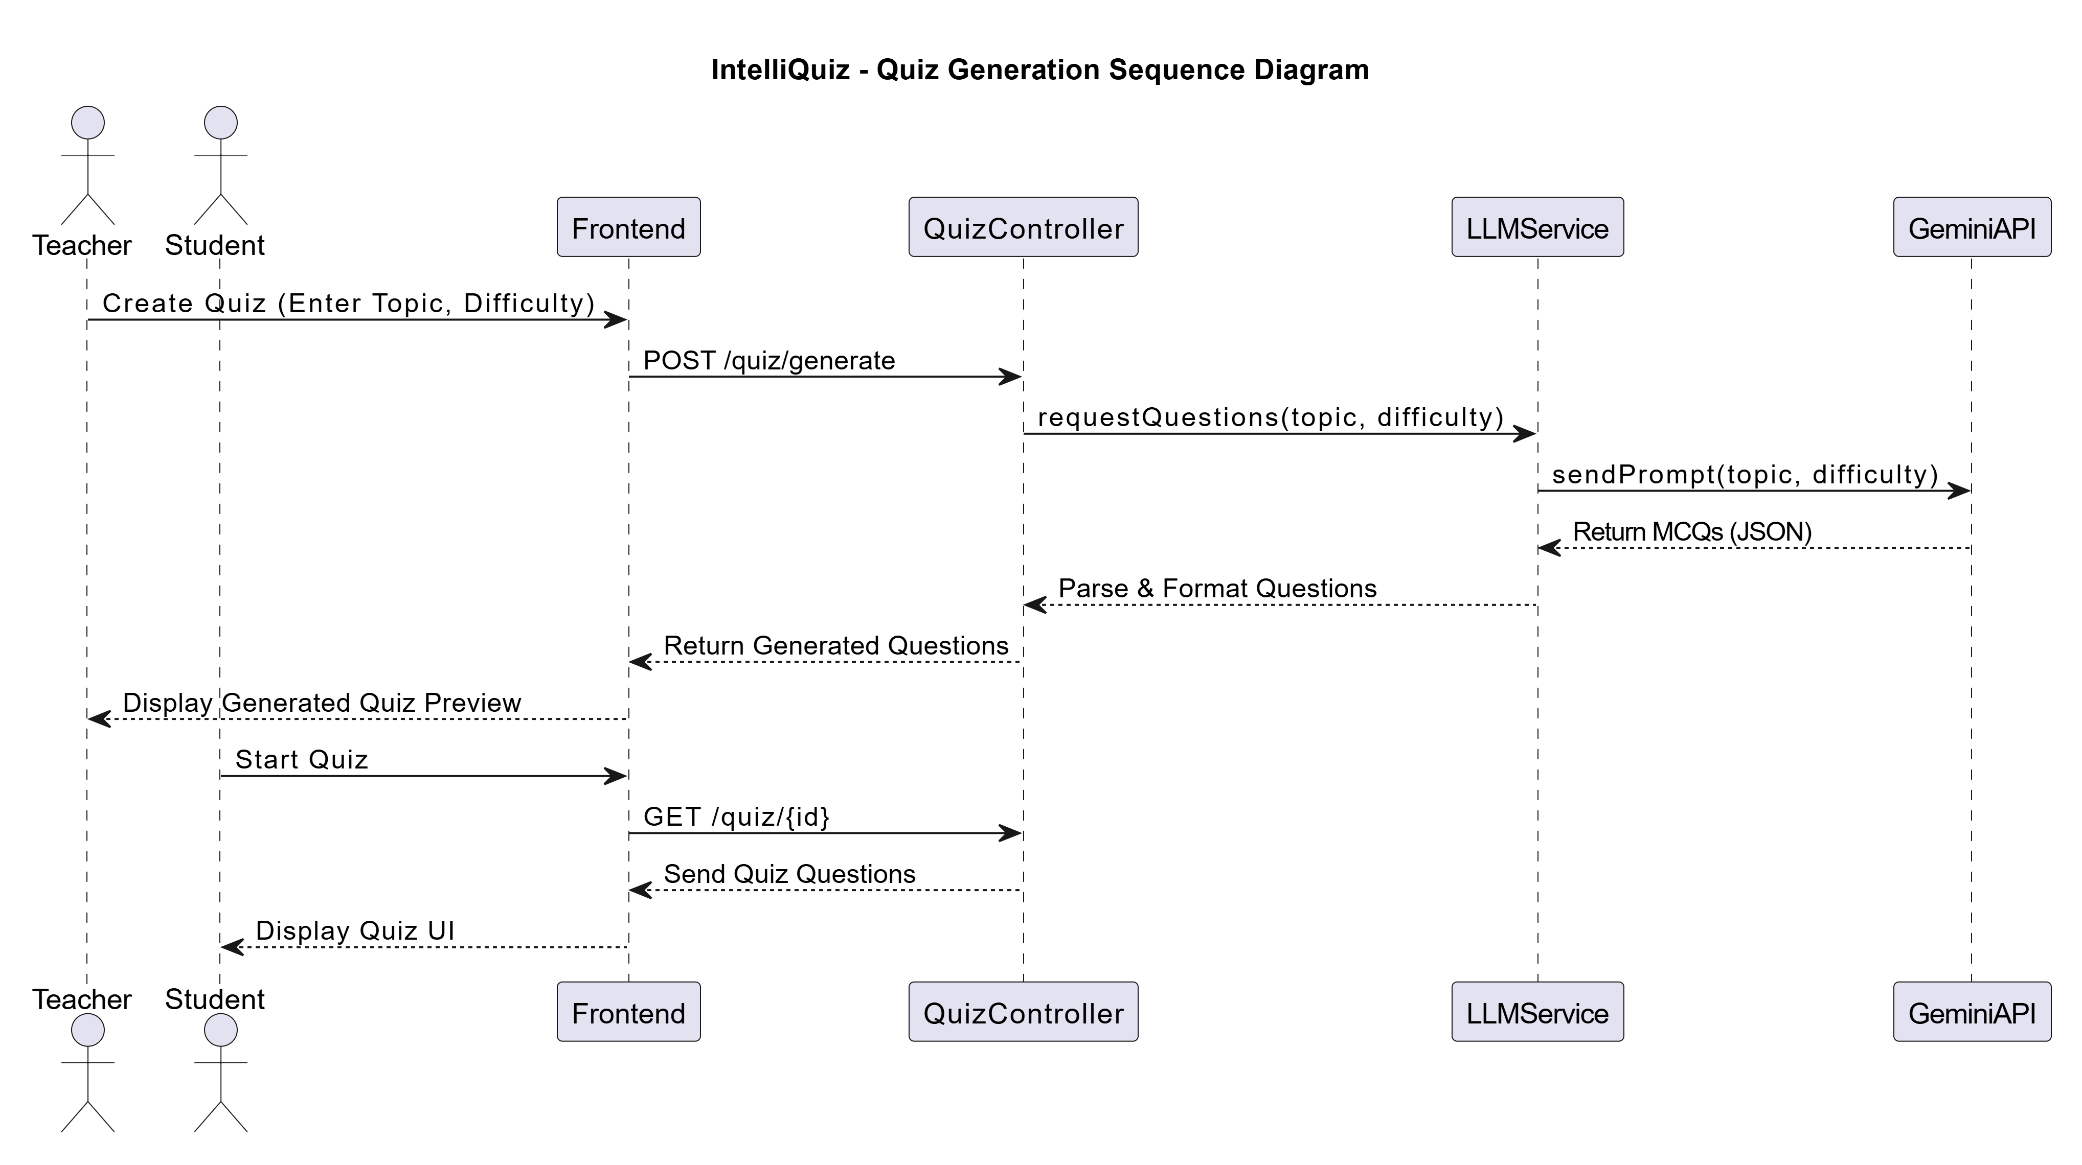
IntelliQuiz Sequence Diagram

Slide 13
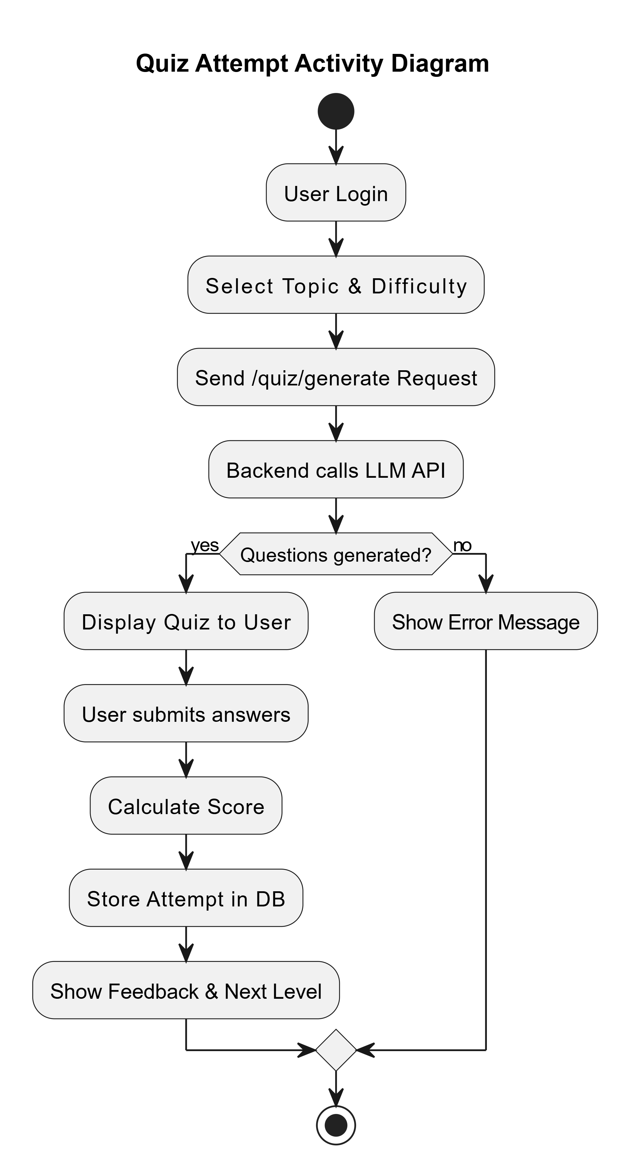
IntelliQuiz Activity Diagram

Slide 14
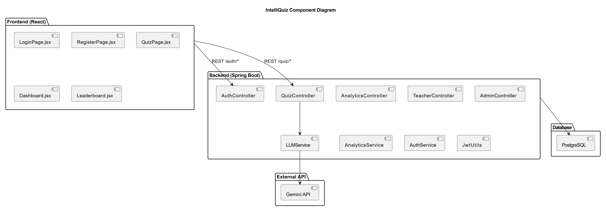
IntelliQuiz Component Diagram

Slide 15
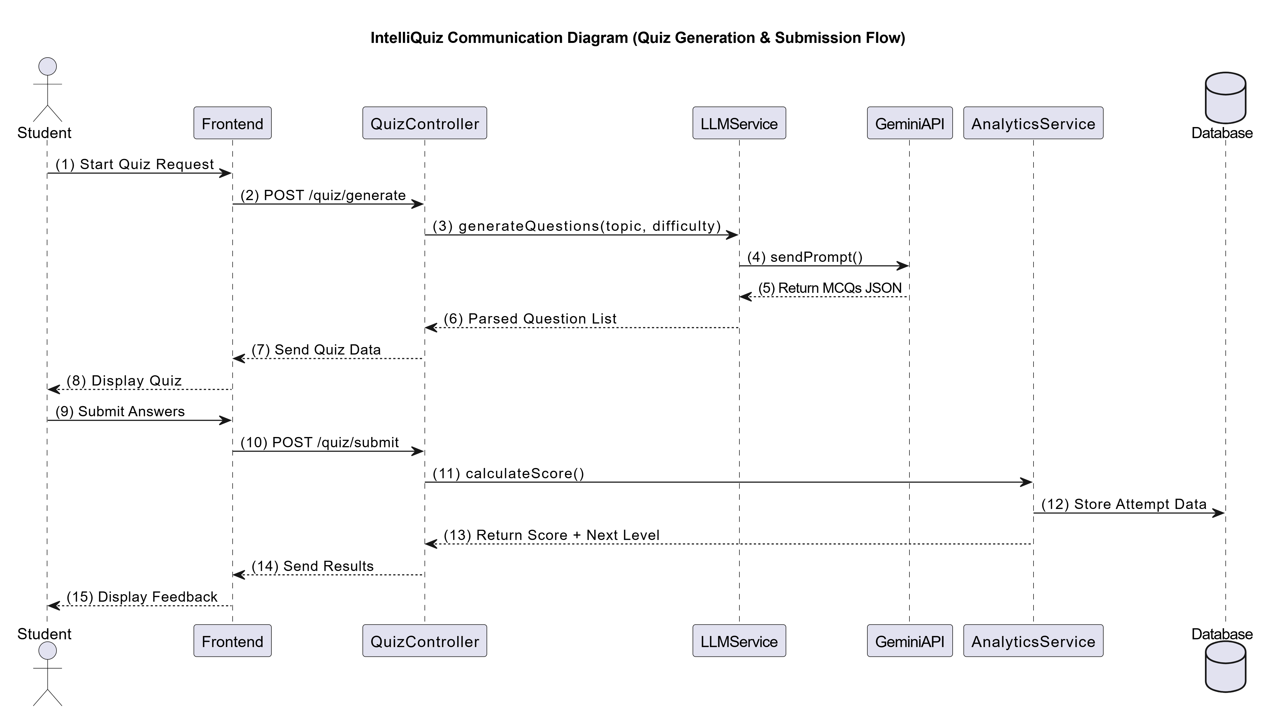
IntelliQuiz Communication Diagram

Slide 16
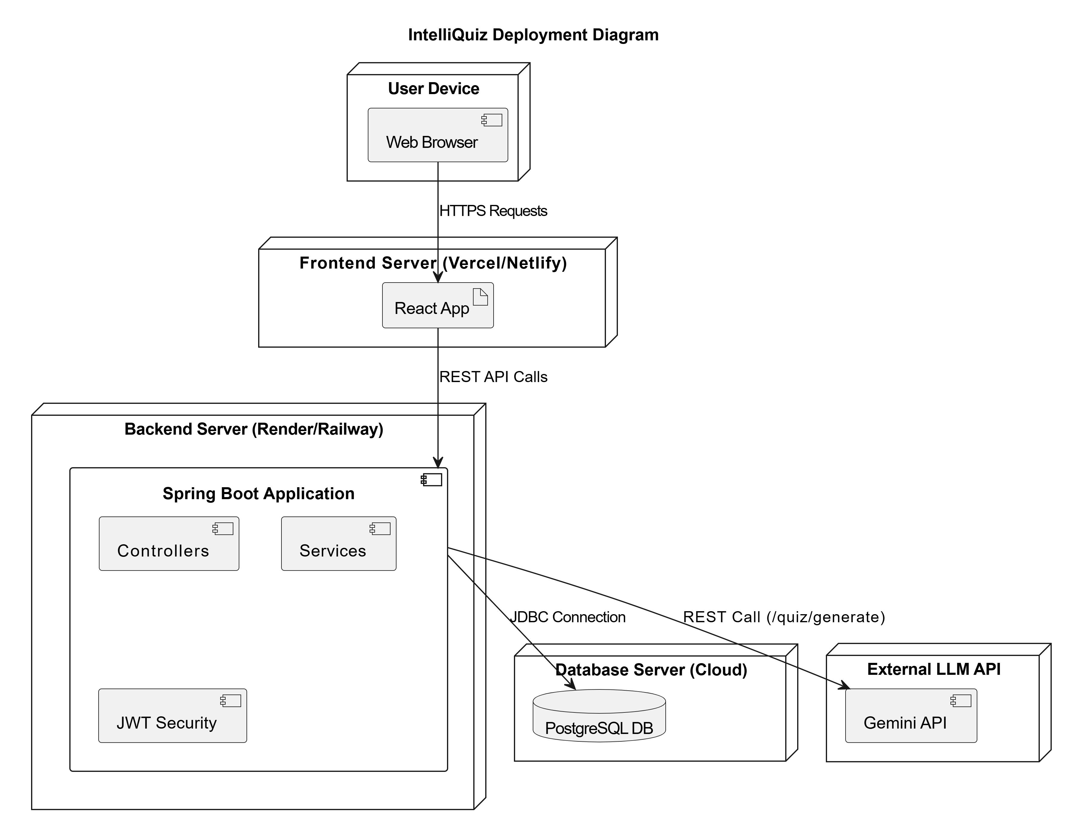
IntelliQuiz Deployment Diagram

Slide 17
IMPLEMENTATION

Slide 18
THANK YOU

